Slide 1

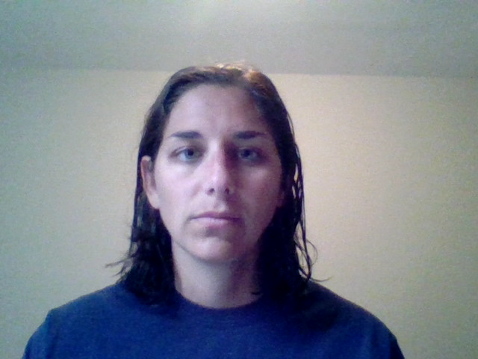
Techie Talk
Notes:
1
Thank you for joining in for the Marine Safety Centers Techie Talk.
Todays discussion will be on Cargo Authority Attachments (CAA).
We will start the discussion with how to request a CAA and a few nuances within the process and then shift to some key items for inspectors and submitters.

Slide 2
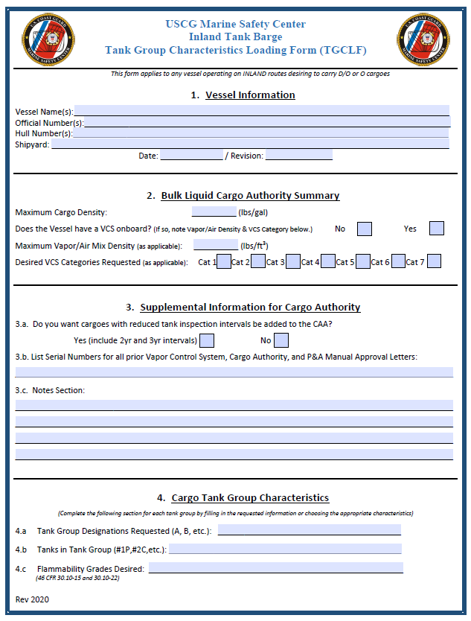
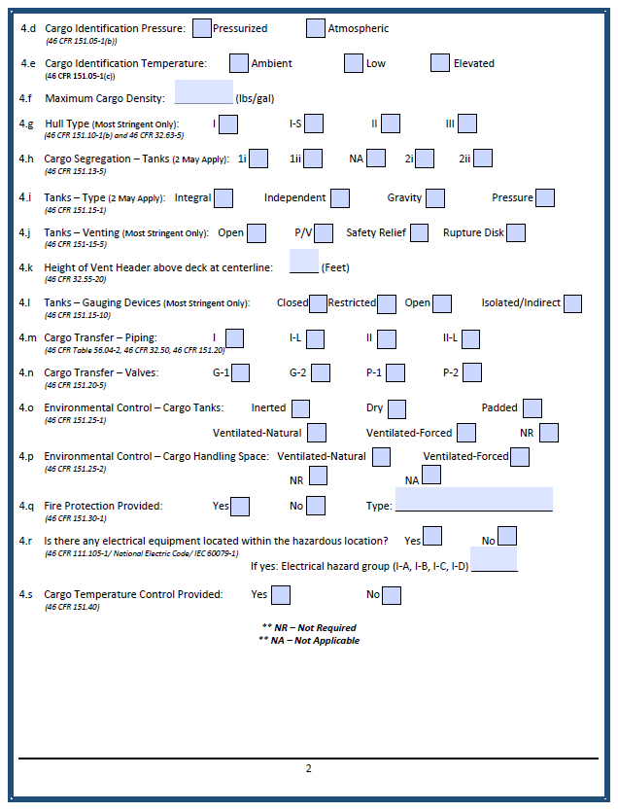
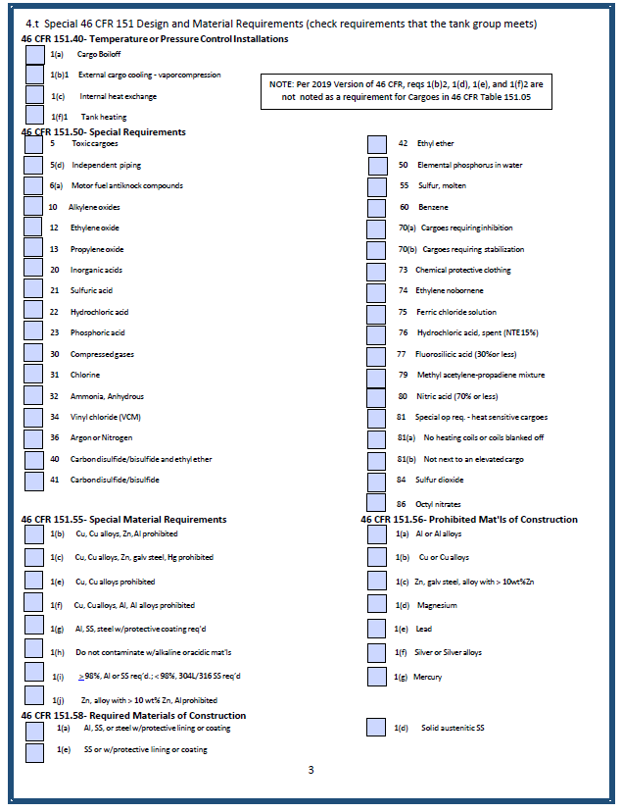
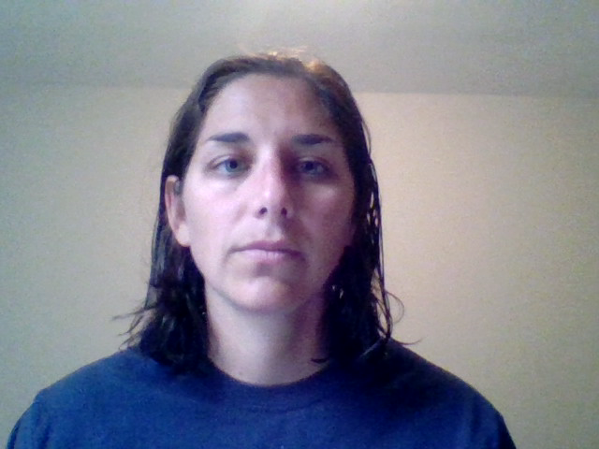
Notes:
2
To request a CAA, the company will need to submit a Tank Group Characteristics Loading Form (TGCLF) to the Marine Safety Center for review and approval. Upon a complete review of the TGCLF, a CAA will be drafted and released to the Officer in Charge of Marine Inspections (OCMI). Please note: If the vessel name and/or the official number are not finalized at the time of this review, the CAA will be held at the Marine Safety Center until the name and official number given to the MSC. If your company is operating on inland routes and is not intending to have an official number assigned to the vessel, please note this and request the CG number be used as an alternative to the Official Number.

Slide 3
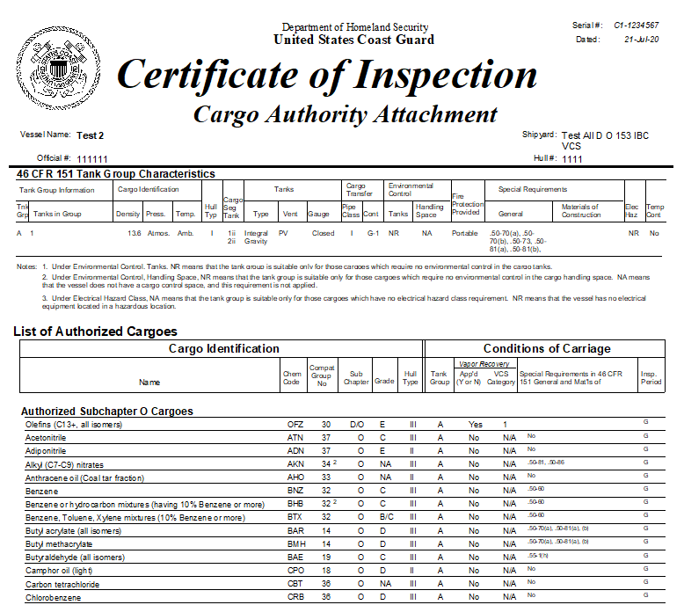
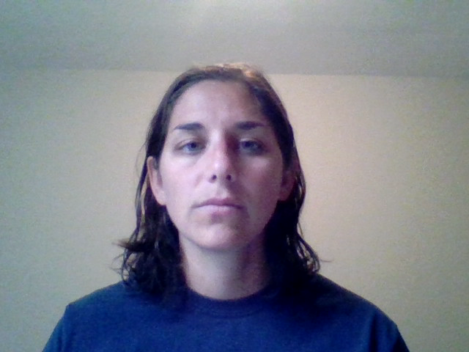
Notes:
3
It is important to note that Cargo Authority Attachments are route specific. Inspectors are encouraged to review the approved cargo list to ensure the cargoes annotated are appropriate for the route of transit. As inspectors prepare for the Certificate of Inspection, it is critical to ensure that the vessel meets the compliance conditions noted on the CAA summary of characteristics. Any issues should be reported to the MSC for correction.
At the end of the day, it is critical that the issued CAA is appropriate for the vessel it is attached to. Inspectors are a key piece of this equation, so please take time to validate the vessel characteristics.
All approval letters released from the MSC will include a list off recommended comments for the COI itself. Inspectors are highly encouraged to review the approval letter and all attachments to ensure there are no items outstanding for the OCMI to verify.

Slide 4
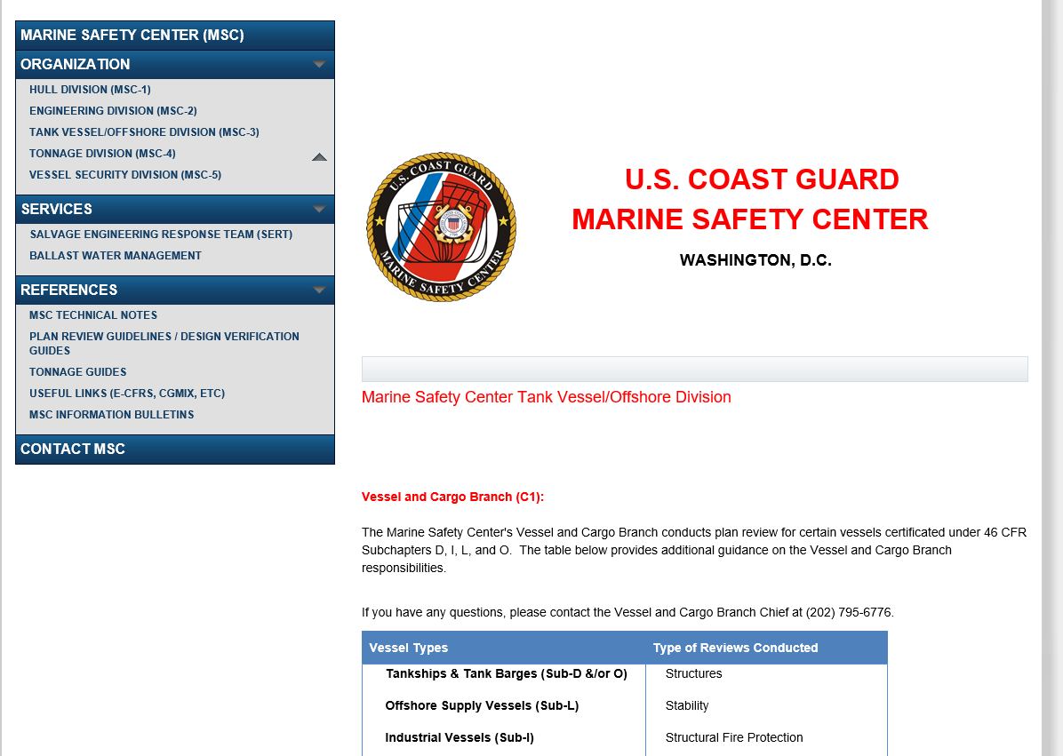

Visit the Marine Safety Center Website for any document noted in this discussion. All items will be listed under Tank Vessel/Offshore Division (MSC-3).
Notes:
4

Slide 5
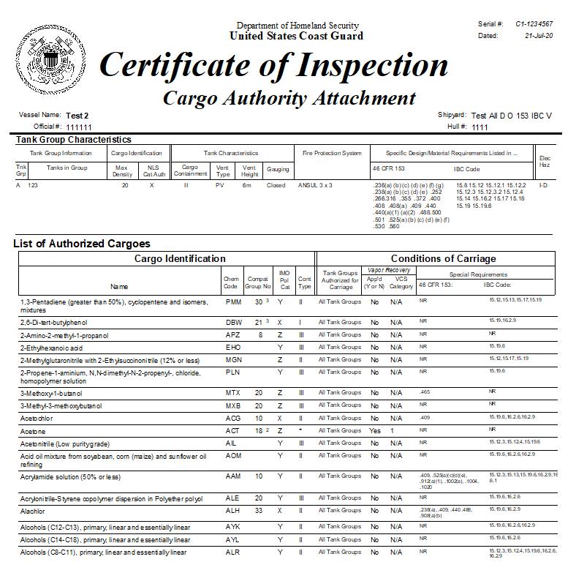
Notes:
5

